Slide 1

Methods

Slide 2
Arguments passing
Arguments passing in java is always ‘pass by value’.
Two types of arguments can be passed in a method call
        -- Primitive type
        -- Reference type

Slide 3
Passing primitive type
public class Test{
public static void swap(int reg1,int reg2){
int temp;
temp=reg1;
reg1=reg2;
reg2=temp; }
public static void main(String args[]){
int r1=10, r2=20;
swap(r1,r2);
System.out.println(“r1=”+ r1);
System.out.println(“r2=”+r2);
}}
The program prints r1=10 and r2=20.

Slide 4
Passing reference type
public class Test{
public static void swap(Student p,Student q){
Student temp;
temp=p;
p=q;
q=temp;
}
public static void main(String a[]){
Student s1=new Student(“John”);
Student s2=new Student(“Mary”);
swap(s1,s2);
System.out.println(“s1=”+ s1.getName());
System.out.println(“s2=”+ s2.getName()
}
}
The program prints :
s1=John
s2=Mary

Slide 5
stack
q
p
swap(s1,s2)
heap
s2
s1
Mary..
John..
main()
After swap() s1 and s2 of main remains unchanged and p and q are no longer available.

Slide 6
Changing the member variable value of an object reference that is passed
public class Test{
public static void change(Student p){
p.setName(“Mary”);
}
public static void main(String args[]){
Student s1=new Student(“John”);
change(s1);
System.out.println(“s1=”+ s1.getName());}
}

Slide 7
stack
p
heap
John
change(s1)
Mary
s1
main()
Change made to the member variable ‘name’ reflected in main().
Prints Mary.

Slide 8
What about arrays?
Suppose we were write a sort method which takes an array of Student objects and sorts the array based on their names.
Will the change be reflected in the calling method?

Slide 9
stack
s
heap
sort(s1)
0
s1
1
Mary..
main()
John..
Changes made to the array content reflected in the main method.

Slide 10

What is the result when you execute the following?
class StudentTest{
public static void main(String args[]){
Student s1[]=new Student[2];
s1[0]=new Student("Mary");
s1[1]=new Student("John");
change(s1);
for(int i=0;i<s1.length;i++){
System.out.println("Name: " + s1[i].getName());
}
}
public static void change(Student s[]){
Student temp[]=new Student[1];
temp[0]= new Student("Meena");
s=temp; } }

Slide 11
Var-args
Allows you to specify that a method can take multiple arguments of same type. The number arguments may be 0, one or more.
void go(int… x)
void go(char c, int… x)
void go(Animal… a)
In a method only the last argument can be of variable length.

Slide 12
Accessing var-args
public class Person{
public Person(String name, String… nicknames)
{
if(nicknames.length!=0){
for(String nm:nicknames)
System.out.println(nm);
System.out.println(nicknames[0]);
} }}

Slide 13
In how many different ways can we call this method?
  Person(“Harry Potter”);
  Person(“Harry Potter”,”Chosen One”)
  Person(“Harry Potter”,”Chosen One”,”Potter Boy”);
  Person(“Harry",new String[]{”Chosen One”,”Potter Boy”});

Slide 14
public static void main(String... args)
is also valid way of defining main method
Collect your thoughts…
static void vararg1(int[] i) &
static void vararg2(int… i))
Are both same ?

Slide 15
Overloading
public class CollegeUtility {
public static void sortStudent(Student s[]){
..}
public static void sortCollege(College c[]){
..}
public static void sortFaculties(Faculty c[])
{..}}
So many sort method names !

Slide 16
public class CollegeUtility {
public static void sort(Student s[]){..}
public static void sort(College c[]){..}
public static void sort(Faculty c[]){..}
public static void sort(Facility c[]){..}
}
Overloading sort method – much simpler
Overloading refers to the methods in a class having same name but different arguments

Slide 17
Overloading
Same method names in a class having different
  types of arguments or
  number of arguments or
  order of arguments
Resolution
  Exact Match
  Automatic Conversion
  More Specific Match
  Ambiguous Match
  No Match

Slide 18
Overloaded method resolution
List1:All the methods where the name and number of arguments of calling method == name and number of arguments of called method
Error: No matching method found
List1 is empty
yes
Error
no
List2: From list1, find all the methods that exactly match the argument type of calling method.
yes
List2 contains > 1 element

Slide 19
no
List2 contains 1 element
yes
no
Matching method found
List3: Find all the methods from List1 where arguments of calling methods are automatically convertible into arguments of called methods.
yes
List3 contains= 1 element
no

Slide 20
no
List3 contains 0 element
yes
Error
no
List4: Find among the methods in List 3 methods which are more specific
List4 contains 1 element
yes
Matching method found
no
Error

Slide 21
Examples
public class StudentTest{
public static void display( regno){
System.out.println(“Registration No. "+regno);
}
public static void display(String name){
System.out.println(“Name. "+name);
}
public static void main(String str[]){
Student s1=new Student(“Mary”);
display(s1.getName());
display(s1.getRegNo());
}}
//exact match
int
int

Slide 22
Examples
public class StudentTest{
public static void display( regno){
System.out.println(“Registration No. "+regno);
}
public static void display(String name){
System.out.println(“Name. "+name);
}
public static void main(String str[]){
Student s1=new Student(“Mary”);
display(s1.getName());
display(s1.getRegNo());
}}
//automatic conversion
long
int

Slide 23
public class Fee {
int id;
double amtPaid;
void pay( id,double amt){
this.id=id;
amtPaid=amt;
}
void pay( id,float amt){
this.id=id;
amtPaid=amt; }
public static void main(String[] args) {
Fee f1= new Fee();
f1.pay(123,400);
}}
//more specific
int
int

Slide 24
public class Fee {
int id;
double amtPaid;
void pay( id,double amt){
this.id=id;
amtPaid=amt;
}
void pay( id,float amt){
this.id=id;
amtPaid=amt; }
public static void main(String[] args) {
Fee f1= new Fee();
f1.pay(123,400);
}}
//ambiguous
float
double

Slide 25
Overloading with var-args
class AddVarargs {
static void go(int x, int y) { System.out.println("int,int");
}
static void go(byte... x) { System.out.println("byte... "); }
public static void main(String[] args){
byte b = 5;
go(b,b);
}
}
var-args is the last argument that will be resolved

Slide 26

public class Test{
static void count( objs){
System.out.println(objs.length);
}
public static void main(String[] args) {
Fee f1= new Fee();
f1.pay(123,400);
}
}
String…
int...
What will this print?
Prints:
3
2
1
count(1, 2, 3);
count(1,2);
count(1);
count(“1”, “2”, “3”);
count(“1”,”2”);
count(“1”);
count(null,null,null)
count(null,null);
count(null);
Prints:
3
2
NullPointerException
count(new String[] { null }); → prints 1

Slide 27

public class Test{
public static void f(double... d){
System.out.println("doubles");
}
public static void f(int... i){
System.out.println("ints");
}
public static void main(String[] args) {
}}
What will this print?
f(new int[]{1, 2});
Prints : ints
f(new double[]{1.2, 2.2});
Prints : doubles
f(1,2);
The method f(double[]) is ambiguous for the type Test
Compiler converts vararg(1,2) to vararg(new int[]{1,2}) why should this not work then?
Ok..lets is dig a little bit more deeper

Slide 28
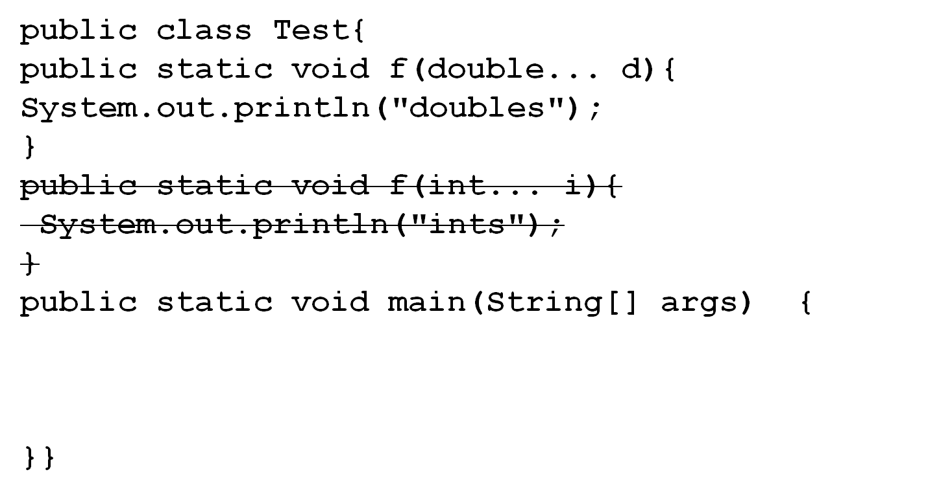

What will this print?
f(new int[]{1, 2});
Compiler error- not applicable
f(new double[]{1.2, 2.2});
Prints : doubles
f(1,2);
Prints : doubles
Compiler converts vararg(1,2) depending on the type of the var-args function defined.

Slide 29
Array of varargs
public class Test {
void display(String[]... vals) {
for(int i = 0; i < vals.length; i++) {
for(int j = 0; j < vals[i].length; j++) {
System.out.println(vals[i][j]);
} }
}
public static void main(String[] args) {
Test t = new Test();
String[] s1 =new String[]{“Red,",”Yellow"};
String[] s2 = new String[]{“Mars",“Jupiter"};
t.display(s1, s2);
}
}

Slide 30
Initializers
Initializers are blocks of code that are used to initialize member variables.
    Static Initializers
      Used to initialize static variables
      Invoked once when the class is loaded
      Syntax
        static { <<statements>>}
    Non-Static Initializers
      Used to initialize instance variables
      Invoked everytime object is created
      Syntax
        { <<statements>>}

Slide 31

But I can declare and initialize variables in same line like this:
class X{
int var=1;
..
}
Why will I require a block of code ?
Initializers are required if our initialization requires computation that results in a set of java statements!

Slide 32

I can put that code in the constructor !
For static variables, if you want them to be initialized before objects are created then static initializer is the only place.
For instance variables, you can avoid the repeat of same code in all the constructors by using instance initializer

Slide 33
public class Voting{
public static final int MAX=50;
public static String voteList[]= new String[5];
static int count=-1;
public String candId=null;
public String voterId=null;
static{
for(int i=0;i<5;i++)
voteList[i]=“ID”+i;
}
{
if(count>=MAX){
{System.out.print("cannot exceed 50");
System.exit(0);}
count++;
}}

Slide 34
Voting(String id,String canid){
this.candId=canid;
for(String vote: voteList)
if(vote.equals(id))
this.voterId=id;
else
this.voterId=“unknown”;
}
Voting(String id){
this.candId=canid;
this.voterId=“undecided”;
}
}

Slide 35
Initializations order
class W{
public W(){System.out.println("W constructor");}
}
public class Z{
W w= new W();
{
System.out.println("instance block");
}
static{
System.out.println("static block");
}
public Z(){System.out.println("Z constructor");
}
public static void main(String st[]){
new Z();}}

Slide 36
Output:
static block
W constructor
instance block
Z constructor
Can you guess what will be printed if you comment ‘new Z()’ in main()?
How will the output look if you have a static block for W class also?
Type the code and find and analyze the results.
How many .class files are created?

